Slide 1

Mountains of the Moon university Faculty of Science, Technology and innovation Department of Computer Science BIT 1201: INFORMATION MANAGEMENT
The Information Management concept
Program: BIT 2101
Instructor: MutabaruraDuncan
Phone Number:+256 774393863
Email: dunmta@mmu.ac.ug

Slide 2
Introduction
Massive amount of information is realized every
year that goes by.
Information is derived from data.
This data can be structured, semi-structured or
even unstructured.
Research has it that over 80% of an organization's information today exists as unstructured data and
this keeps doubling annually.
File servers, different databases, isolated exchange
folders & disconnected document repositories
are major sources.
Notes:
Structured data is data that has been organized into a formatted repository,
is information that either does not have a pre-defined data model or is not organized in a pre-defined manne

Slide 3
What needs to be managed?
It is therefore very important to manage;
Web Content
Enterprise data i.e.
Academic
Human Resource
Financial
E-Mail
Documents
Academic collections
Digital Library
Research
Digital Assets…E.t.c.
Video
Audio
Photography

Slide 4
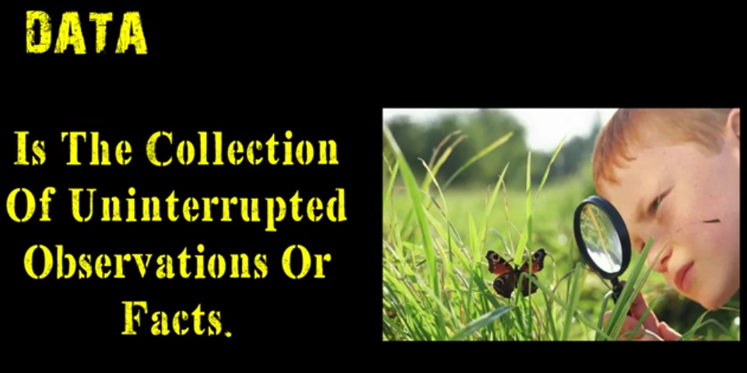

Slide 5
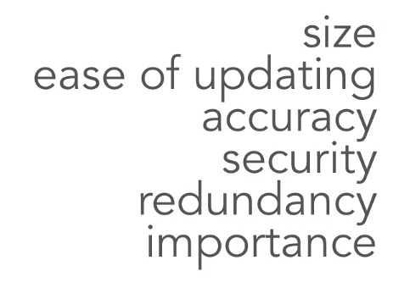
Having data is not a problem, the problem is what comes next
Notes:
size---seacrhn
ease of updating....2 pipo udating overtring
Accuracy--missing
Security..shared, pay who views
Redundancy, duplication

Slide 6
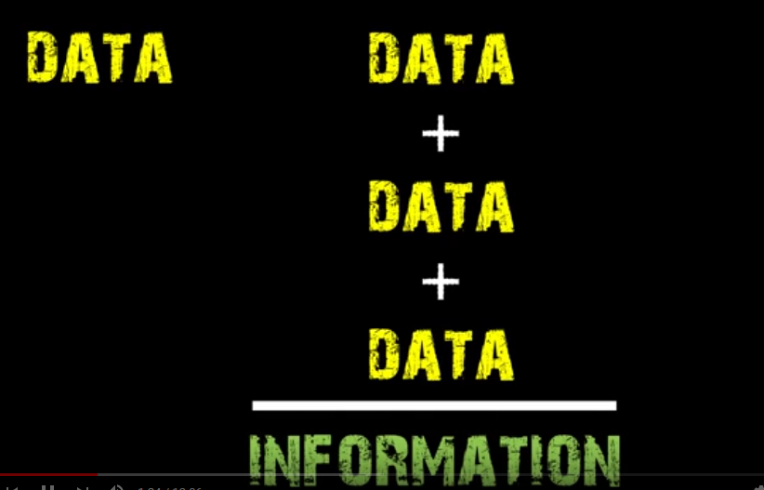
What needs to be managed?

Slide 7
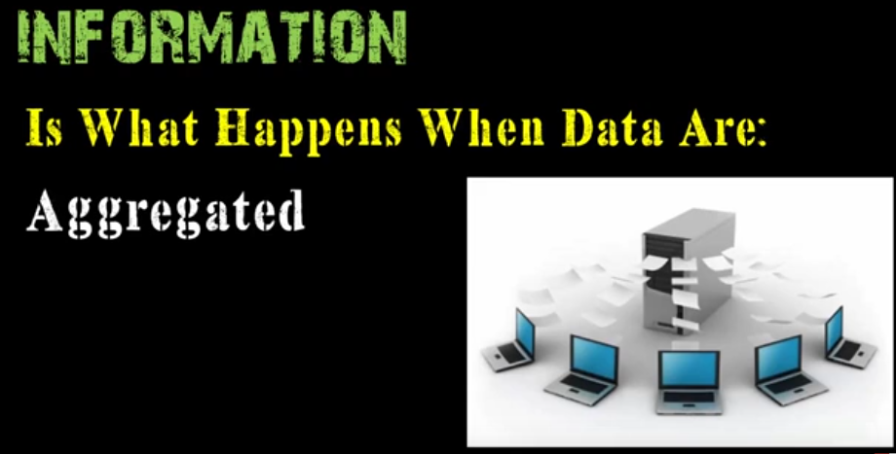
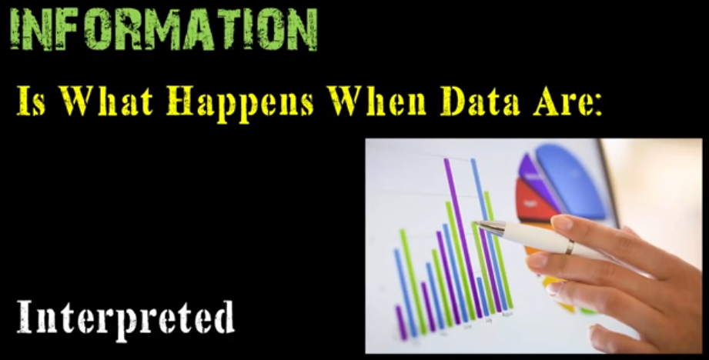
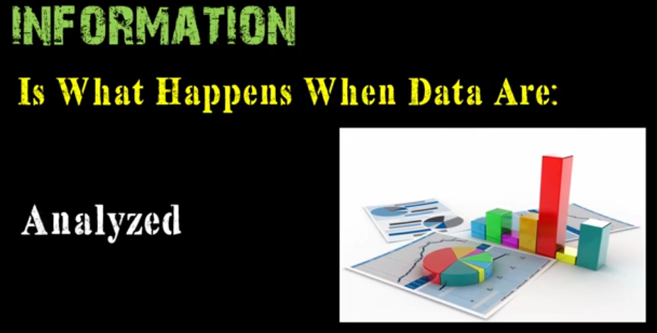
Information
Notes:
aggregate data are data combined from several measurements. When data is aggregated, groups of observations are replaced with summary statistics based on those observations. In a data warehouse, the use of aggregate data dramatically reduces the time to query large sets of data.

Slide 8
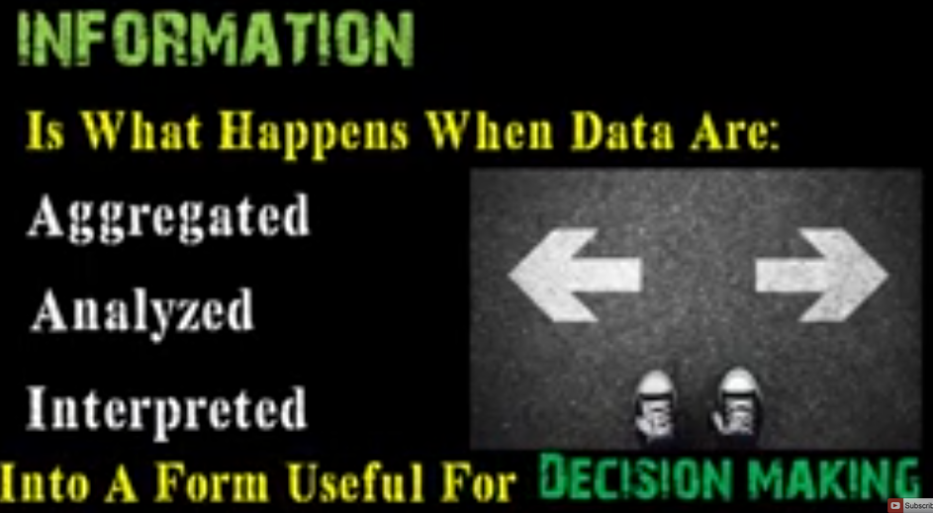
Information

Slide 9
Data, Information, Knowledge - Relationships
Data
Information
Knowledge

Slide 10
Data Vs Information
Data, Information, Knowledge - Relationships
Data: Are raw facts about objects. In databases,
these are the stored values but they may not
necessarily be meaningful.
Information: This is data or facts with meaning /
Processed data.
Knowledge refers to the understanding of or information about a subject that you get by experience or study, either known by one person or by
people generally.

Slide 11
Data, Information, Knowledge - Relationships
Relationships between data, information and knowledge
For example,
- data provides building blocks for information and
information does so for knowledge;
- knowledge facilitates creation of information from data;
- new data changes information, new information changes
knowledge

Slide 12
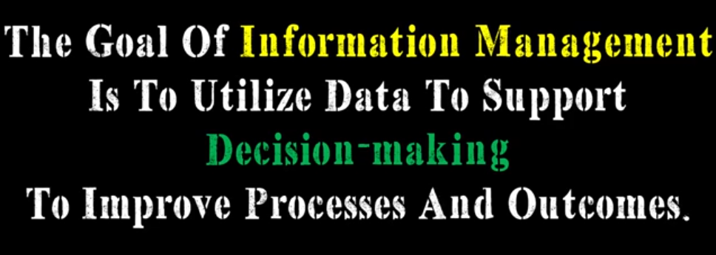

Slide 13
Managing Information - Life Cycle Metaphor
Collect,
Create
Discard
(after x cycles)
Store
Filter
Organize
Update
Retrieve
Use
Transfer,
Share
Knowledge management uses similar cycle

Slide 14



A Real Life Perspective…………………
Example in Healthcare……………

Slide 15
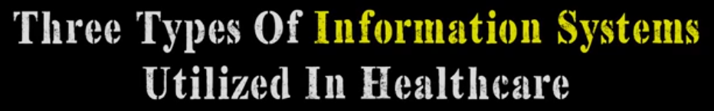
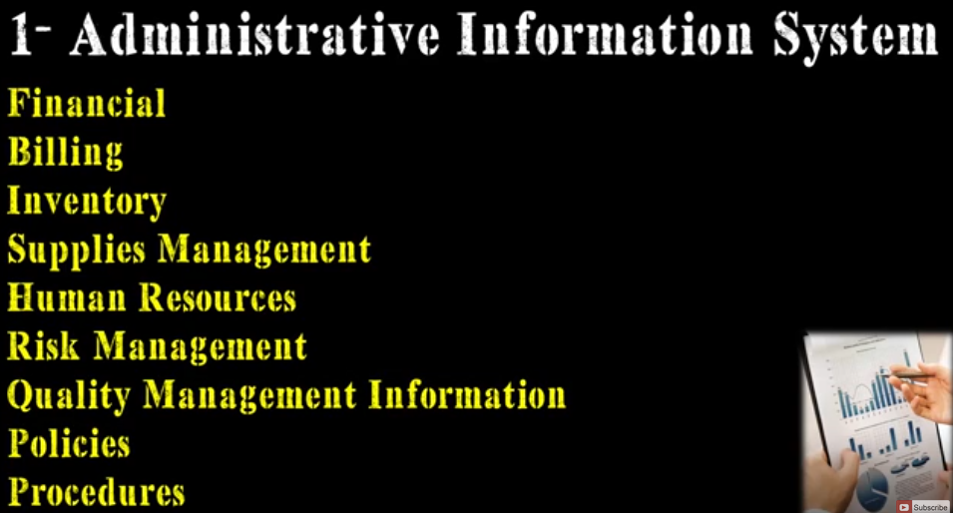

Slide 16
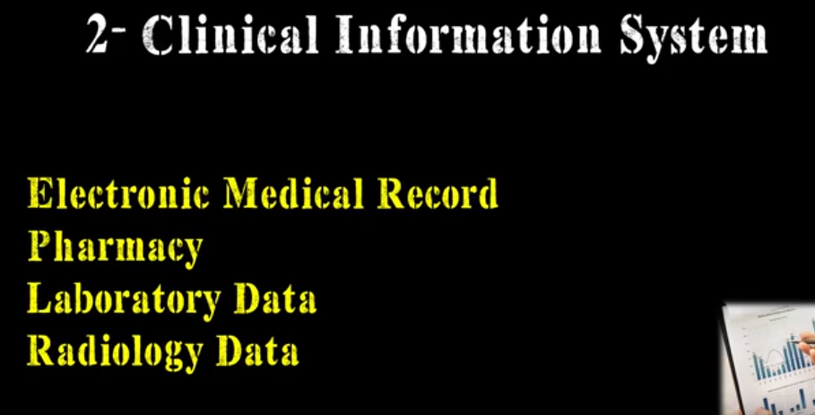

Slide 17
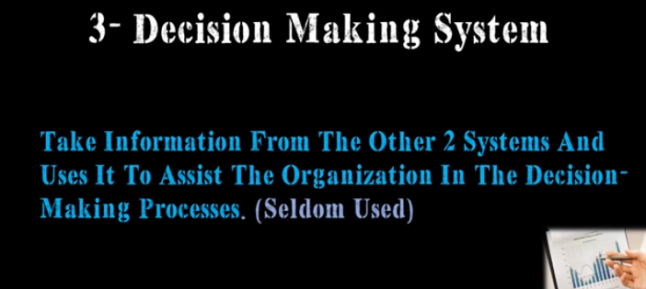


Slide 18
IM on scholarly perspective……
Lewis and Martin stressed that numerous Authors
have attempted to define Information management, hence varying definitions.
Many of the earlier definitions have been conceptualized in the context of large organizations. Therefore the purpose of information management is: “to promote organizational
effectiveness by enhancing the capabilities of the
organization to cope with the demands of its internal and
the external environment in dynamic as well as stable
conditions”.

Slide 19
Information Management cont’d
Information management has an organizational
focus, emphasizes information content and requires
high-level data administration techniques based
upon the planning and control of information
assets in support of organizational aims and
objectives.
It’s stated that all of us are Information Managers.
We all manage information at a formal and
structured personal level, as well as informal and
less structured.
Information management can also be defined as the planning, organizing, directing & controlling of information within an open system (organization).

Slide 20
Information management cont’d
Note: Information management is therefore viewed as using technology (e.g. computers, information systems, IT) and techniques like information auditing/mapping to effectively and efficiently manage information resources and assets from internal and external sources
This is to enhance pro-active decision making and
problem-solving to achieve aims and objectives at different organizational levels i.e. personal, operational, organizational, and strategic levels for competitive advantage and to improve performance of the system to raise the quality of life of the individual.

Slide 21
Primary elements of information
There are three primary elements of information which answer the questions of:
Relevance answers “What is needed?”
Timelines answers “When is it required?”
Accuracy answers “How is it required? “
Other elements that must be considered
along side relevance.
Complete
Simple

Slide 22
Note:
Merely because information is relevant does not
imply it is complete or in the most effective
format (i.e. simple).
If you receive information and you do not make a decision based on it, you do not need it then.
A request for more information is not a
decision – it just shows that you didn’t get the
right information in the first place.
A decision to do nothing is a not decision.

Slide 23
Note:
Decisions cannot change the past, but only the
future. The past is only useful to predict the future.
You need to communicate your objectives and the
related decisions to your information providers.
Information providers should then tailor the
information they provide to the recipients’
requirements.

Slide 24
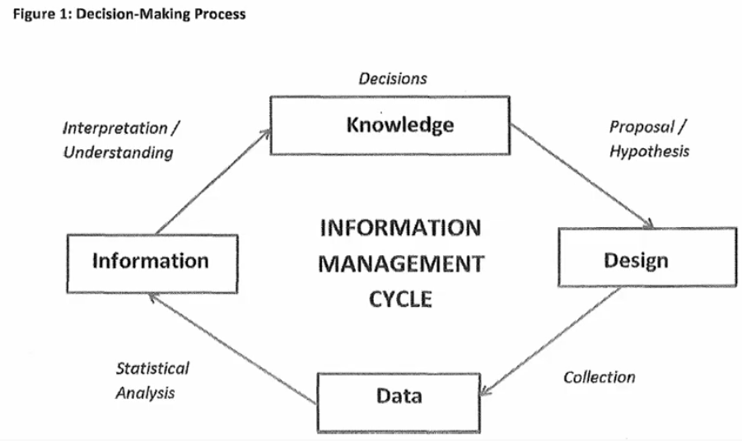

Slide 25
Definition of terms cont’d
Structured data:
Data with a rigid and complete identifiable arrangement
e.g. relational databases, etc.
data is organized in semantic chunks (entities)
similar entities are grouped together(relations or classes)
entities in the same group have the same descriptions
(attributes)
descriptions for all entities in a group (schema)
have the same defined format
have a predefined length
and follow the same order

Slide 26
Unstructured data
Unstructured data
Its data with no clearly identifiable arrangement e.g. Text, video,sound, images
data can be of any type.
not necessarily following any format or sequence.
does not follow any rules.
is not predictable.

Slide 27
Semi structured data:
Semi structured data:
Data with some structure but may not be rigid
and complete.
data is available electronically in
database systems
file systems, e.g., Web data
attempt to reconcile database and document

Slide 28
Thank You

